Slide 1
The Revelation of Jesus Christ
Vision 4, Part 2 (16:12-21 ) - Review, Bowls 6-7

Slide 2
Looking back
“Write the things which you have seen, and the things which are, and the things which will take place after this.” (Revelation 1:19)
Series of 6 visions
Begin with John seeing a sign
End with a proleptic view of the day of judgment
1:1 — angels “signified” the revelation to John; communicated through symbols

Slide 3
First three visions
Vision 1, Chapters 1-3: the glorified Christ and the seven churches of Asia
Vision 2, Chapters 4-11 - what happens to the Roman Empire; judgment for her sins
Vision 3, Chapters 12-14
The dragon (Satan)
The beast (the Roman Church)
The false prophet (the Papacy)
The image of the beast (Holy Roman Empire)

Slide 4
Vision 4 - God’s judgment of the beast
Bowls 1-4 represent France rebelling from Catholic Church
Bowl 5 represents Italy reducing the kingdom of the Papacy from the Papal States to the Vatican
In less than100 years, the Catholic Church (the beast) lost:
Its closest ally in Europe, France
The Holy Roman Empire (ended by Napoleon in 1806)
Vast amounts of territory across Europe
The Papal States

Slide 5
Looking ahead
Vision 4 - God’s judgment of the beast and false prophet concludes
Bowl #6 - decline and fall of the Ottoman Turk Empire, groundwork laid for Armageddon
Bowl #7 - the World Wars decimate the kingdom of the beast (Europe)
Chapters 17-18 - reflections on Babylon
Chapter 19 - Jesus defeats the beast and false prophet (Armageddon)
Vision 5, Chapter 20 - God defeats the dragon (Armageddon) and judges the world
Vision 6, Chapters 21-22 - Heaven

Slide 6
Bowl 6 - 16:12-16
Then the sixth angel poured out his bowl on the great river Euphrates, and its water was dried up, so that the way of the kings from the east might be prepared. And I saw three unclean spirits like frogs coming out of the mouth of the dragon, out of the mouth of the beast, and out of the mouth of the false prophet. For they are spirits of demons, performing signs, which go out to the kings of the earth and of the whole world, to gather them to the battle of that great day of God Almighty. "Behold, I am coming as a thief. Blessed is he who watches, and keeps his garments, lest he walk naked and they see his shame." And they gathered them together to the place called in Hebrew, Armageddon.

Slide 7
6, 6, 6
Sixth seal prepares us for the seven trumpets with the sealing of the 144,000
The sixth trumpet sets the stage for the 1,260 years and the seven bowls of wrath
The sixth bowl of wrath prepares us for “the battle of that great day of God Almighty” depicted in 19:11-20

Slide 8
What John saw
“the great River Euphrates” - a barrier to the east; represents the Turkic powers (i.e. trumpet #6)
“dried up” - a gradual decline in power
“frogs”
An unclean animal with a harsh voice
Represent unclean spirits (see verse 14, cf. with 1 Timothy 4:1)

Slide 9
more of what John saw
“out of the mouths of…”
The beast - Rome, the Catholic Church,
The false prophet - the Papacy
The dragon - Satan
“which go out to”
“the kings of the earth” - the ten kingdoms which arose out of imperial Rome
“the kings…of the whole world” - those nations beyond

Slide 10
Armageddon
“Armageddon” = Har Megiddo, the “hill of Megiddo”
Solomon built an important military stronghold at Megiddo
Guards an important trade route connecting Egypt with Mesopotamia — a link between Europe, Asia, and Africa
Sight of many important historical battles
Symbolizes the last great spiritual struggle between God and His enemies (“the battle of that great day of God Almighty”)
Notes:
“Armageddon” = Har Megiddo, the “hill of Megiddo”
Solomon built an important military stronghold at Megiddo
End of the Fertile Crescent, the joining point of three continents – Europe, Asia, Africa
An important trade route, the Via Maris, runs through a mountain pass guarded by Megiddo, connecting Egypt with Mesopotamia.
The Jezreel Valley was the sight of great historical battles
Gideon’s 300 men fought at the Hill of Moreh in Jezreel
Saul and Jonathan died at Jezreel
King Ahaziah of Judah died at Megiddo about 842 BCE, and King Josiah of Judah also died there (609 BCE) while opposing the advance of the Egyptian king Necho II toward Assyria.
A symbol of the last great spiritual struggle between the Lord and Satan (lawless one is destroyed with the brightness of Christ's coming – II Thess. 2)

Slide 11
The decline of the Ottoman Empire

Slide 12
Trumpet #6 - the Turkic power
Originated in Central Asia, migrated into the Middle East
Seljuk Turks crossed the Euphrates in 1057, threaten the Byzantine Empire
1095 - First Crusade called by Pope Urban
Seljuk Turks replaced by Ottoman Turks; conquer Constantinople in 1453
1481-1566 - peak of Turkic power and wealth
1683 - repelled from Vienna; reached its greatest extent in territory

Slide 14
Decline of Ottoman Empire
Europe advanced in shipbuilding and navigation; expanded trade and naval capabilities
Influx of American gold and silver into European coffers; created a trade imbalance
Industrial revolution widened technical skills gap
Medical advances in Europe lengthened life expectancy and health
Europe grew into a powerhouse while Turkic power gradually waned

Slide 15
Notes:
Prior to World War 1 European powers were gradually absorbing more and more Ottoman territories.
France occupied Algeria, (1830-1902), Morocco (1912), and Tunisia (1881).
Italy occupied Lybia (1911-1932)
Britain occupied Egypt (1882), Sudan (1899) and the southeastern coast of the Arabian pennisula (1839 and 1861)
Russia’s pressure from the north compelled the Ottomans to ally with Germany.

Slide 16
Ottoman Empire defeated in WW1
Turkey becomes an independent republic
England and France divide the rest
Encourages the growth of education
Sparks the growth of Middle Eastern nationalism
1960’s - final vestiges of European dominion are lost; many new sovereign nations emerge
“…so that the way of the kings from the east might be prepared”

Slide 18
Armageddon

Slide 19
Late 19th/early 20th Deceiving spirits
July 18, 1870 - The Vatican Council, papal infallibility
The foundations of fascism and communism are laid
The scientific establishment grows skeptical of faith
European philosophy grows antagonistic toward Christianity
Europe begins to discard Christianity, replacing it with atheism and humanism
Attempts to unite the world (e.g. The League of Nations, The U.N.)

Slide 20
Their purpose
To gather the kings of the earth “to the battle of that great day of God Almighty.”
“And I saw the beast, the kings of the earth, and their armies, gathered together to make war against Him who sat on the horse and against His army.” (Revelation 19:19)
“Now when the thousand years have expired, Satan will be released from his prison and will go out to deceive the nations which are in the four corners of the earth, Gog and Magog, to gather them together to battle, whose number is as the sand of the sea. They went up on the breadth of the earth and surrounded the camp of the saints and the beloved city. And fire came down from God out of heaven and devoured them.” (Revelation 20:7-9)

Slide 21
“Behold, I am coming as a thief. Blessed is he who watches, and keeps his garments, lest he walk naked and they see his shame.”
– Revelation 16:15

Slide 22
He returns like “a thief”
To the church in Sardis: “Remember therefore how you have received and heard; hold fast and repent. Therefore if you will not watch, I will come upon you as a thief, and you will not know what hour I will come upon you.” (Revelation 3:3)
“Watch therefore, for you do not know what hour your Lord is coming. But know this, that if the master of the house had known what hour the thief would come, he would have watched and not allowed his house to be broken into. Therefore you also be ready, for the Son of Man is coming at an hour you do not expect.” (Matthew 24:42-44)
See also 1 Thessalonians 5:2-3 and 2 Peter 3:10-11
Notes:
1 Thessalonians 5:2-3
For you yourselves know perfectly that the day of the Lord so comes as a thief in the night. For when they say, “Peace and safety!” then sudden destruction comes upon them, as labor pains upon a pregnant woman. And they shall not escape.
2 Peter 3:10-11
The Day of the Lord
But the day of the Lord will come as a thief in the night, in which the heavens will pass away with a great noise, and the elements will melt with fervent heat; both the earth and the works that are in it will be burned up. Therefore, since all these things will be dissolved, what manner of persons ought you to be in holy conduct and godliness,

Slide 23
“Look at the fig tree, and all the trees. When they are already budding, you see and know for yourselves that summer is now near. So you also, when you see these things happening, know that the kingdom of God is near…But take heed to yourselves, lest your hearts be weighed down with carousing, drunkenness, and cares of this life, and that Day come on you unexpectedly. For it will come as a snare on all those who dwell on the face of the whole earth. Watch therefore, and pray always that you may be counted worthy to escape all these things that will come to pass, and to stand before the Son of Man.”
–Luke 21:29-31, 34-36

Slide 24
Bowl 7, 16:17-21
Then the seventh angel poured out his bowl into the air, and a loud voice came out of the temple of heaven, from the throne, saying, "It is done!" And there were noises and thunderings and lightnings; and there was a great earthquake, such a mighty and great earthquake as had not occurred since men were on the earth. Now the great city was divided into three parts, and the cities of the nations fell. And great Babylon was remembered before God, to give her the cup of the wine of the fierceness of His wrath. Then every island fled away, and the mountains were not found. And great hail from heaven fell upon men, each hailstone about the weight of a talent. Men blasphemed God because of the plague of the hail, since that plague was exceedingly great.

Slide 25
What John saw
This bowl is poured out on the air
The atmosphere above us
The dominion of Satan: he is “the prince of the power of the air” (Ephesians 2:2)
“noises and thunderings and lightnings…And great hail…” - the complete judgment of God
Psalm 18:13-15 and Revelation 11:19
“earthquake” — a shakeup of social and political institutions
Notes:
Psalms 18:13-15
The LORD thundered from heaven,
And the Most High uttered His voice,
Hailstones and coals of fire.
He sent out His arrows and scattered the foe,
Lightnings in abundance, and He vanquished them.
Then the channels of the sea were seen,
The foundations of the world were uncovered
At Your rebuke, O LORD,
At the blast of the breath of Your nostrils.
Revelation 11:19
Then the temple of God was opened in heaven, and the ark of His covenant was seen in His temple. And there were lightnings, noises, thunderings, an earthquake, and great hail.

Slide 26
More of what John saw
“such a mighty and great earthquake as had not occurred since men were on the earth” - no other time in human history would rival the instability of this time.
“And great Babylon was remembered before God, to give her the cup of the wine of the fierceness of His wrath”
Babylon = the “great city;” represents those who collude and comply with the beast
Revelation 14:9-10, “If anyone worships the beast and his image, and receives his mark on his forehead or on his hand, [10] he himself shall also drink of the wine of the wrath of God, which is poured out full strength into the cup of His indignation. He shall be tormented with fire and brimstone in the presence of the holy angels and in the presence of the Lamb.”

Slide 27
still more of what John saw
“the great city was divided into three parts” — no longer unified; fractured
“every island fled away, and the mountains were not found” - the nations once aligned with Babylon abandoned her
“Men blasphemed God because of the plague of the hail, since that plague was exceedingly great.”
Echoes bowls 4 (16:9) and 5 (16:11)
The bowls of wrath should have provoked repentance; instead, mankind was further entrenched in rebellion

Slide 28
The world wars

Slide 29
“The hundred years after 1900 were without question the bloodiest century in modern history, far more violent in relative as well as absolute terms than any previous era. Significantly larger percentages of the world's population were killed in the two world wars that dominated the century than had been killed in any previous conflict of comparable geopolitical magnitude (see Figure I.). Although wars between 'great powers' were more frequent in earlier centuries, the world wars were unparalleled in their severity (battle deaths per year) and concentration (battle deaths per nation-year)…”

Slide 30
“By any measure, the Second World War was the greatest man-made catastrophe of all time. And yet, for all the attention they have attracted from historians, the world wars were only two of many twentieth-century conflicts. Death tolls quite probably passed the million mark in more than a dozen others.* Comparable fatalities were caused by the genocidal or 'politicidal' wars waged against civilian populations by the Young Turk regime during the First World War, the Soviet regime from the 1920s until the 1950s and the National Socialist regime in Germany between 1933 and 1945, to say nothing of the tyranny of Pol Pot in Cambodia.”
–Ferguson, The War of the World, p. xxxiv

Slide 31
Connect the symbolism with history
Verse 18, “such a mighty and great earthquake as had not occurred since men were on the earth”
Ferguson, “By any measure, the Second World War was the greatest man-made catastrophe of all time.”
Hailstones falling from heaven = the advance of artillery, aerial bombing, nuclear weapons
“Then every island fled away, and the mountains were not found.” — realignment of world powers
Judgment of Babylon
France and Germany decimated by the two world wars
Two powers most closely aligned with the Catholic Church through the Holy Roman Empire

Slide 32
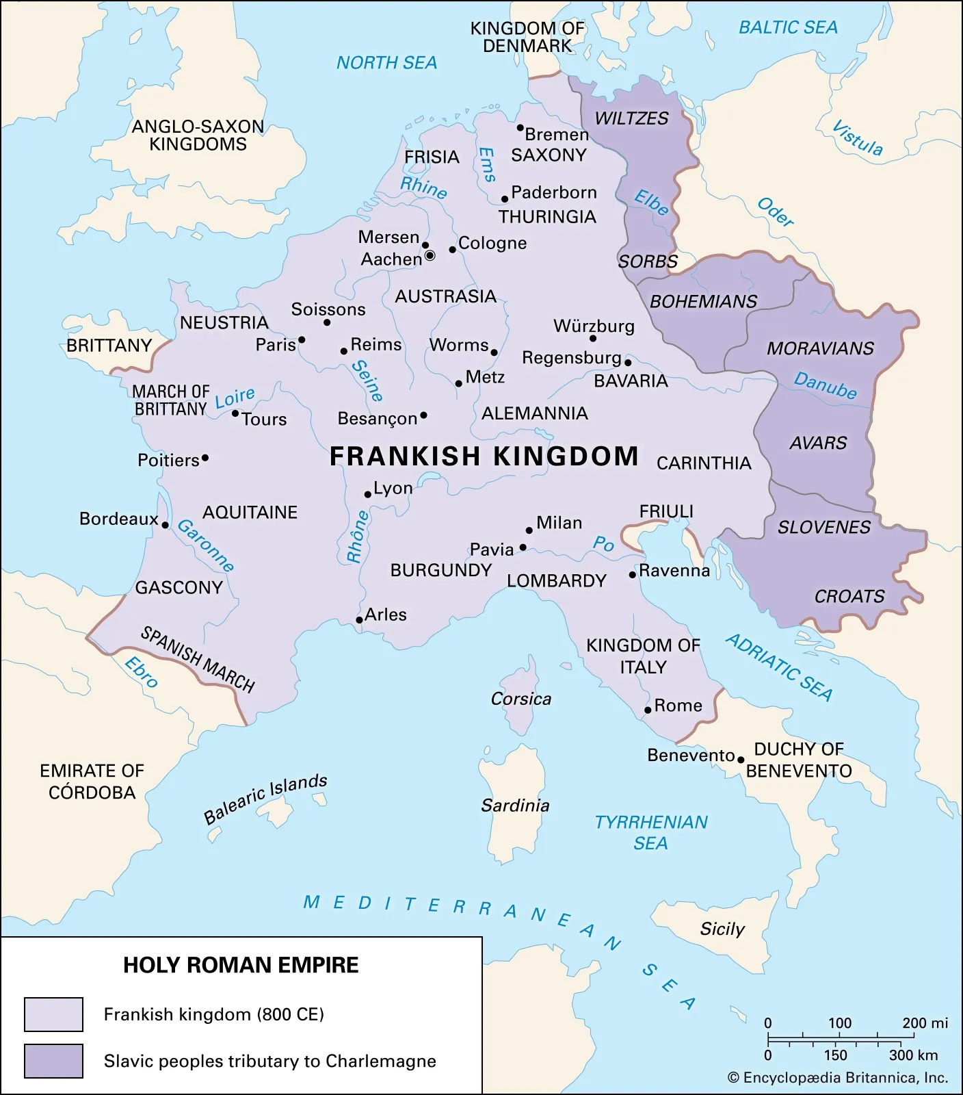
Notes:
Map on the left represents Allied bombing runs during WW2
The size of red dot indicates the tonnage of bombs dropped in these regions
The map on the right is the Holy Roman Empire in 800, at the beginning of Charlemagne’s reign

Slide 34
“Men blasphemed God because of the plague of the hail, since that plague was exceedingly great.”

Slide 35
“But (this) did not happen without sins on our part: for that justice and that care for the poor which (most mendaciously) the Communists advertise, we in reality ought to have brought about ages ago. But far from it: we Westerners preached Christ with our lips, with our actions we brought the slavery of Mammon. We are more guilty than the infidels: for to those that know the will of God and do not do it, the greater the punishment. Now the only refuge lies in contrition and prayer. Long have we erred. In reading the history of Europe, its destructive succession of wars, of avarice, or fratricidal persecutions of Christians by Christians, of luxury, of gluttony, of pride, who could detect any but the rarest traces of the Holy Spirit?”
–C.S. Lewis, The Latin Letters, January 7, 1953

Slide 36
“I certainly feel that very grave dangers hang over us. This results from the great apostasy of the great part of Europe from the Christian faith. Hence, a worse state than the one we were in before we received the faith. For no one returns from Christianity to the same state he was in before Christianity, but into a worse state: the difference between a pagan and an apostate is the difference between an unmarried woman and an adulteress …. Therefore many men of our time have lost not only the supernatural light, but also the natural light which the pagans possessed.”
–C.S. Lewis, The Latin Letters, September 15, 1953

